Slide 1
IVT, EVT and MVT
Recognize, Verify and Utilize
Some AP Exam examples and a nifty theorem
Marshall Ransom – mransom411@gmail.com
or mransom@georgiasouthern.edu

Slide 2
Hypotheses:
1. IVT:
A function is continuous on [a, b]
2. EVT:
A function is continuous on [a, b]
3. MVT:
A function is continuous on [a, b]
…..AND the function is differentiable on (a, b)

Slide 3
Conclusions:
1. IVT:
k between f(a) and f(b) means a<c<b, f(c)=k
There are absolute max and min values of f somewhere on [a, b].
2. EVT:
3. MVT:
(f(b) – f(a))/(b – a) = f ’(c) for a<c<b
i.e., Avg rate of change = f ’(c) somewhere in (a, b)

Slide 4
Some examples from AP Calculus Exams
IVT: 2022AB/BC4 Part b
Justify whether there is a time t in the interval [0, 3] such that:
IS –6 between r’(0) and r’(3)?
IS r’(t) continuous?

Slide 5
is given as twice differentiable and……
t | 0 | 3 | 7 | 10 | 12
 | –6.1 | –5.0 | –4.4 | –3.8 | –3.5
Oh, wow!
–6
Write something: –6.1 < –6 < –5.0
Justify using IVT: r(t) twice differentiable
means that r’(t) is diff, therefore cont.
3. Answer the question: YES

Slide 6
A minimal response probably getting
full credit for applying the IVT:
1. An inequality: f(a) < value < f(b)
2. Justification of hypothesis (continuity)
3. Answer the question

Slide 7
MVT: 2017AB6 Part d
x
–5 | 10 | –3
–4 | 5 | –1
–3 | 2 | 4
–2 | 3 | 1
–1 | 1 | –2
0 | 0 | 3
g is a differentiable function.
Is there c on [–5, – 3] for which g‘(c) = – 4? Justify!!

Slide 8
1. Apply MVT: (g(– 5) – g(– 3))/(– 5 – – 3) = – 4
2. Justify hypotheses:
(i) g is differentiable (given info)
(ii) g is cont because g is differentiable
3. Answer: There is c in (–5, – 3) with g‘(c) = – 4

Slide 9
An EVT Question:
For what values of x does f(x) = x² – x, for x in [0, 3]
have an absolute minimum value?
Simplest method:
Compare values of f at endpoints and critical point(s).

Slide 10
Typical scoring on an AP Exam:
1 point: evidence of f ‘ = 0
NOTE: NOT the same as
asking for the absolute
minimum value of f
1 point: justification
1 point: answer
Do it right: x = ½……… f(1/2)=–1/4…f(0)=0…f(3)=6.
Then circle or indicate ½.

Slide 11
What’s missing from this scoring of EVT work?
Thus far no need to “assert” that f is continuous.

Slide 12
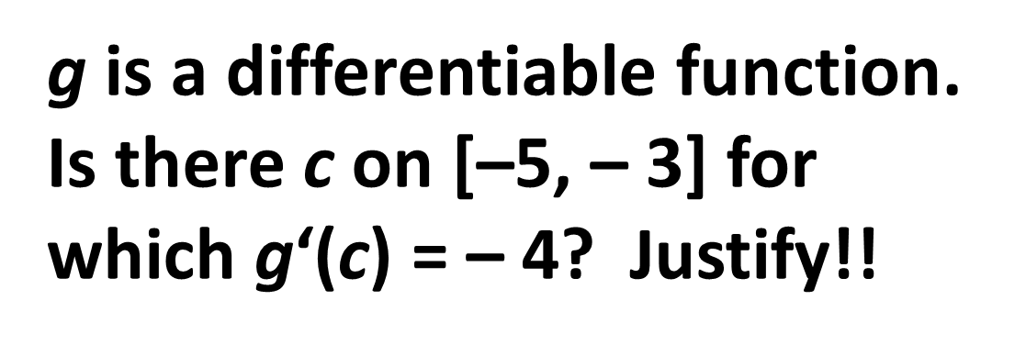
A nifty theorem?
x
–5 | 10 | –3
–4 | 5 | –1
–3 | 2 | 4
–2 | 3 | 1
–1 | 1 | –2
0 | 0 | 3
/–6
Because it’s differentiable we
know g is continuous….. g’ ??
Use of IVT requires continuity!

Slide 13
A derivative does not have to be continuous but…..
.…. a derivative does have the IVT property.
The nifty theorem: If a function f is differentiable on an interval I then for every a<b in I…..if k is between f ‘(a) and f ‘(b) there is a c on [a, b] with f ‘(c) = k.

Slide 14
The proof:
Case 1: f ‘(a)>k>f ‘(b)……..Case 2: f ‘(a)<k<f ‘(b)
GOAL: Find c on [a, b] with f ‘(c) = k.
We will examine Case 1 and search for a MAX.
From the inequality f ‘(a) – k > 0 and 0 > f ‘(b) – k.

Slide 15
We look at Case 1 noting that h ‘(t) = f ‘(t) – k.

Slide 16
3. MAX of h somewhere on [a, b] when f ‘(a)>k>f ‘(b).
by EVT for h. Is h(a) the Maximum value?
At a we have f ‘(a) – k > 0 from the inequality, meaning
h‘(a) = f ‘(a) – k > 0. BUT….. the limit of the difference quotient (h(t) – h(a))/(t – a) < 0. Some confusion???
That means h‘(a) is both + and – ????? NO Max at a.

Slide 17
Is h(b) the Maximum value?
At b we have h‘(b) = f ‘(b) – k < 0 from the inequality.
AND ALSO….. the limit of the difference quotient (h(t) – h(b))/(t – b) > 0. NO Max at b.
h(c) must be the Max, for c with a<c<b.

Slide 18
By Fermat’s theorem, since h’(c) exists, h’(c) = 0.
h’(c) = f ‘(c) – k = 0 meaning that f ‘(c) = k and VOILA!
The “nifty theorem” is known as Darboux’s theorem.

Slide 19
Marshall Ransom
mransom411@gmail.com
OR
mransom@georgiasouthern.edu

